Slide 1

NSG Pilkington – University of Liverpool Machine Learning Project: 03/03/2021
Dr. Peter Green
Diego Echeverria
Sarini Jayasinghe
Risk Institute,
School of Engineering

Slide 2
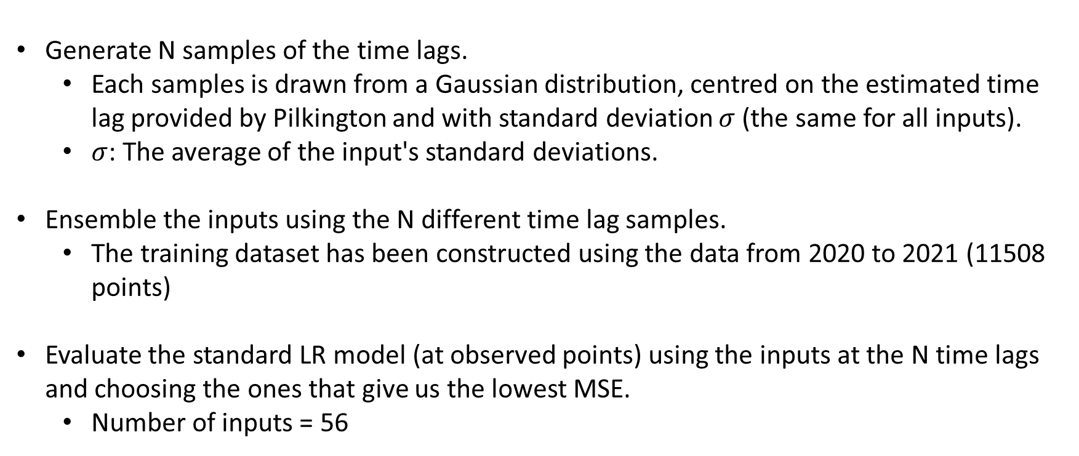
Vary the time lags randomly
Generate N samples of the time lags.
Each samples is drawn from a Gaussian distribution, centred on the estimated time lag provided by Pilkington and with standard deviation $σ$ (the same for all inputs).
$σ$: The average of the input's standard deviations.
Ensemble the inputs using the N different time lag samples.
The training dataset has been constructed using the data from 2020 to 2021 (11508 points)
Evaluate the standard LR model (at observed points) using the inputs at the N time lags and choosing the ones that give us the lowest MSE.
Number of inputs = 56

Slide 3
Vary the time lags randomly: After 500 simulations
Input | Time lags
6539 Bath Pressure (PV) | 3
10425 Calculated Cullet Ratio | 73
1950 Canal Temp. Control Pyrometer (2) | 7
10279 Canal Temp. Control (PV) | 7
11282 Chimney Draught Pressure - After Ecomomiser | 8
2922 Closed Bottom Temperature - Downstream Working End (PV) | 12
2913 Closed Bottom Temperature - Port 1 (PV) | 66
2918 Closed Bottom Temperature - Port 6 (PV) | 62
2921 Closed Bottom Temperature - Upstream Working End (PV) | 73
1650 Combustion Air Temperature Measurement | 35
5134 EEDS Average Gross Width Measurement | 0
11213 Essential Services Board Cat 'B' Supply - MV53 | 5
30208 Feeder Speed Measurement Left | 69
5288 Front Wall Cooling Air Flow (PV) | 0
11201 Furnace & Services Pack Sub S8 L.H. Section - HV13 | 0
11174 Furnace Bottom Temperature 18m D/S of B8 | 70

Slide 4
Vary the time lags randomly: After 500 simulation
10091 Furnace Load | 12
15119 Furnace Pressure (PV) | 11
9393 Glass Level Control (OP) | 10
321 Glass Level Control (PV) | 14
7474 Lehr Drive Line Shaft Speed | 4
6463 Main Gas Pressure (PV) | 39
11211 MV51 | 4
7546 Open Crown Temperature - Port 1 (PV) | 72
7746 Open Crown Temperature - Port 2 (PV) | 71
7673 Open Crown Temperature - Port 5 (PV) | 69
7483 Open Crown Temperature - Port 6 (PV) | 53
10271 Open Crown Temperature - Upstream Refiner (PV) | 40
7520 Open Crown Temperature - Upstream Working End (PV) | 9
7443 Outside Ambient Temperature Measurement | 52
7999 Outside Windspeed Anemometer | 16
11105 Port 1 Combustion Air Flow LHS (OP) | 72
11108 Port 1 Combustion Air Flow RHS (OP) | 67
11111 Port 2 - 3 Combustion Air Flow LHS (OP) | 73
11114 Port 2 - 3 Combustion Air Flow RHS (OP) | 71
9400 Port 2 Gas Flow (SP) | 71
100021 Regenerator Base Temperature Port 1 (combined) | 112
100022 Regenerator Base Temperature Port 2 (combined) | 107
100023 Regenerator Base Temperature Port 3 (combined) | 110
100024 Regenerator Base Temperature Port 4 (combined) | 109
100025 Regenerator Base Temperature Port 5 (combined) | 106
100026 Regenerator Base Temperature Port 6 (combined) | 110
100027 Regenerator Base Temperature Port 7 (combined) | 115
11146 Regenerator Base Temperature Port 8 LHS | 109
100012 Regenerator Crown Temperature Port 2 (combined) | 93
15070 Regenerator Crown Temperature Port 6 RHS | 89
100018 Regenerator Crown Temperature Port 8 (combined) | 90
11221 Services Building MCC1 - MV67 | 0
11217 Services Building MCC9 Cat 'B' Supply - MV60 | 9
8344 Total CCCW Flow Measurement | 0
136 Total Combustion Air Flow Measurement | 38
135 Total Firm Gas Flow Measurement | 32
9282 Tweel Position | 3
30060 U/S Flowing End Air Flow Measurement | 16
11301 UK5 Total Load (Power) | 4
11384 Wobbe Index (Incoming Gas) | 36
Max time lag: 100027 Regenerator base temperature Port 7 = 38 hours

Slide 5
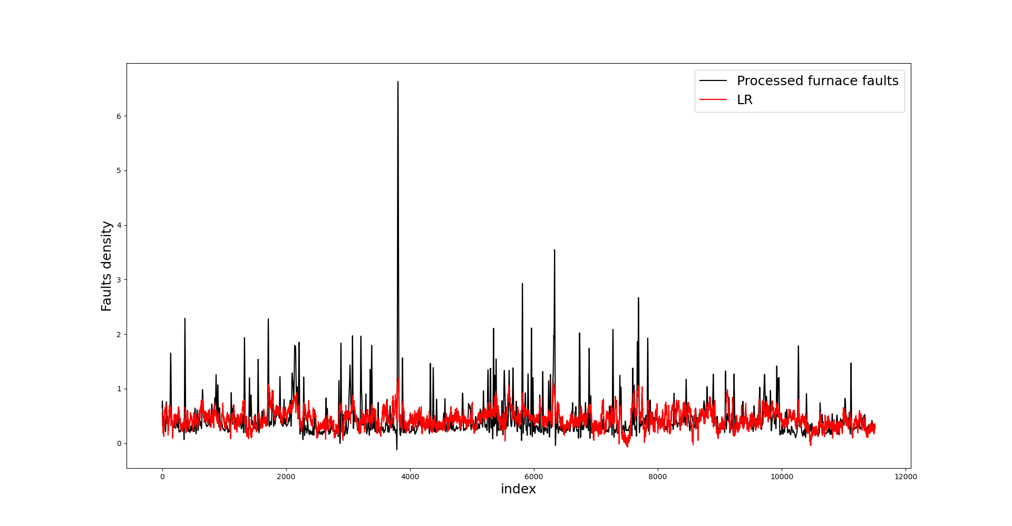
Vary the time lags randomly

Slide 6
Vary the time lags randomly
MSE = 0.1182

Slide 7
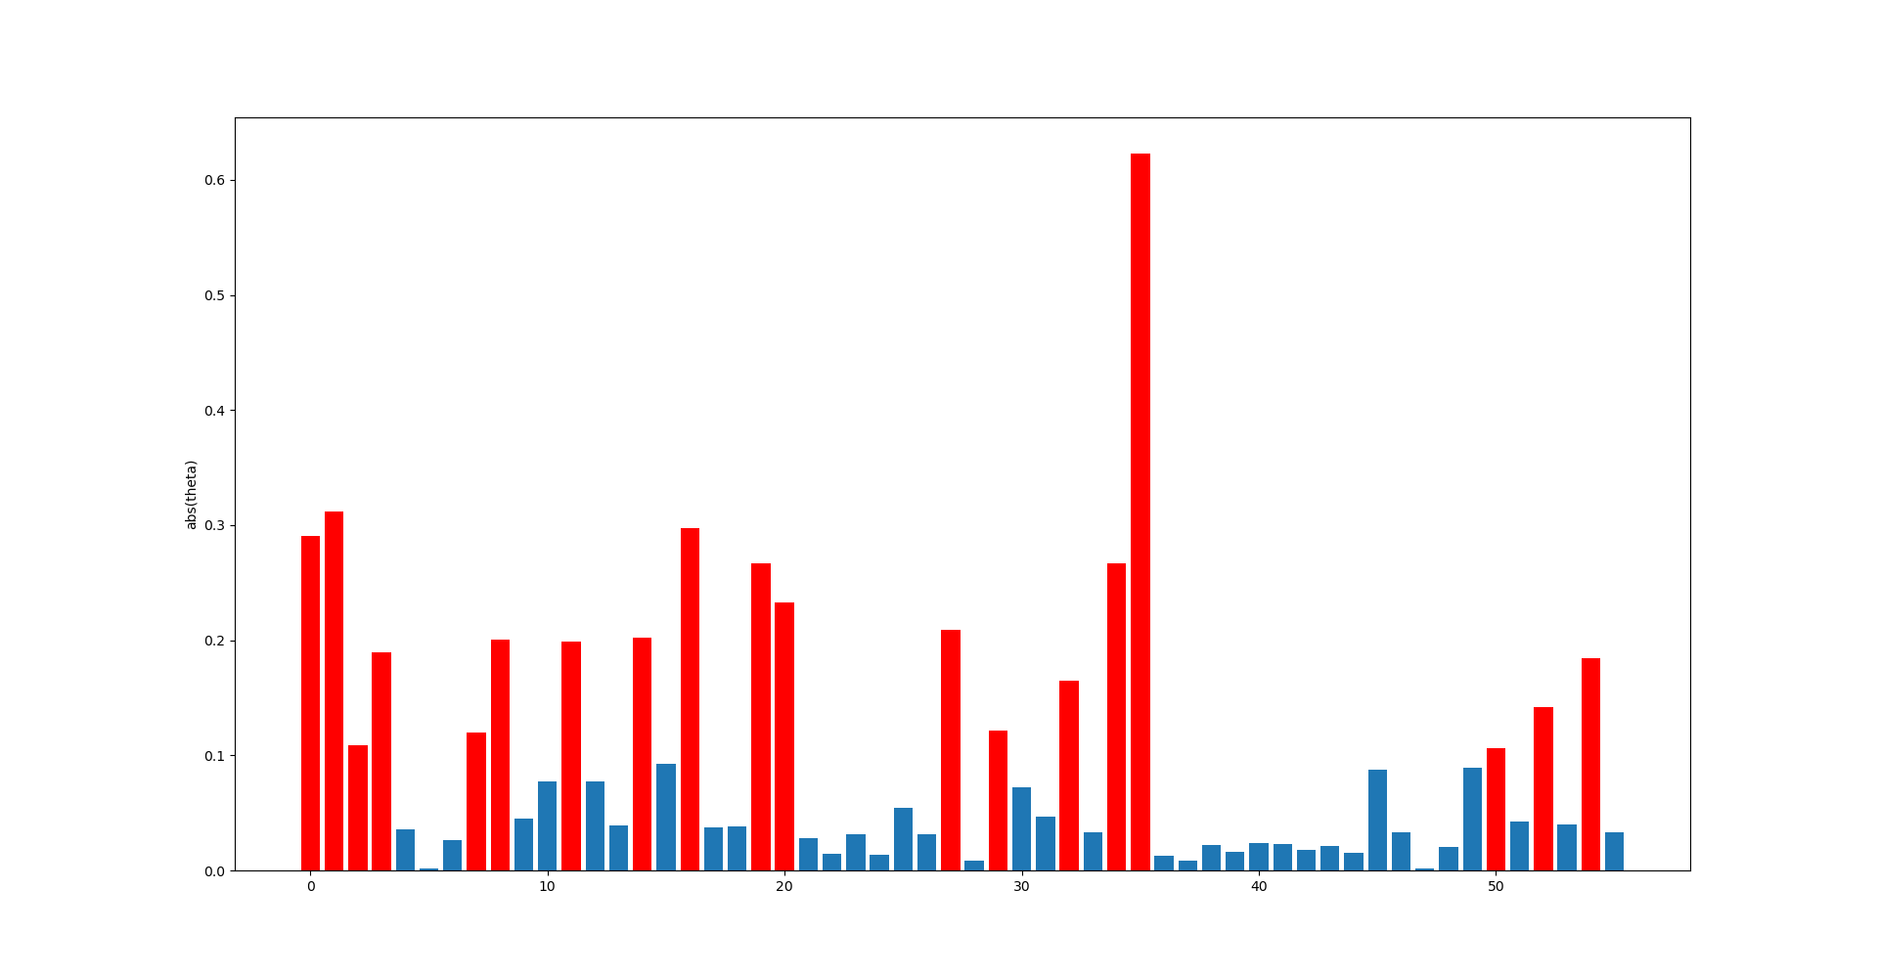
Relevant inputs: abs($θ$) > 0.1
6539 Bath Pressure (PV)
10425 Calculated Cullet Ratio
1950 Canal Temp. Control Pyrometer (2)
10279 Canal Temp. Control (PV)
2918 Closed Bottom Temperature - Port 6 (PV)
2921 Closed Bottom Temperature - Upstream Working End (PV)
11213 Essential Services Board Cat 'B' Supply - MV53
11201 Furnace & Services Pack Sub S8 L.H. Section - HV13
10091 Furnace Load
321 Glass Level Control (PV)
7474 Lehr Drive Line Shaft Speed
10271 Open Crown Temperature - Upstream Refiner (PV)
7443 Outside Ambient Temperature Measurement
11108 Port 1 Combustion Air Flow RHS (OP)
11114 Port 2 - 3 Combustion Air Flow RHS (OP)
9400 Port 2 Gas Flow (SP)
136 Total Combustion Air Flow Measurement
9282 Tweel Position
11301 UK5 Total Load (Power)

Slide 8
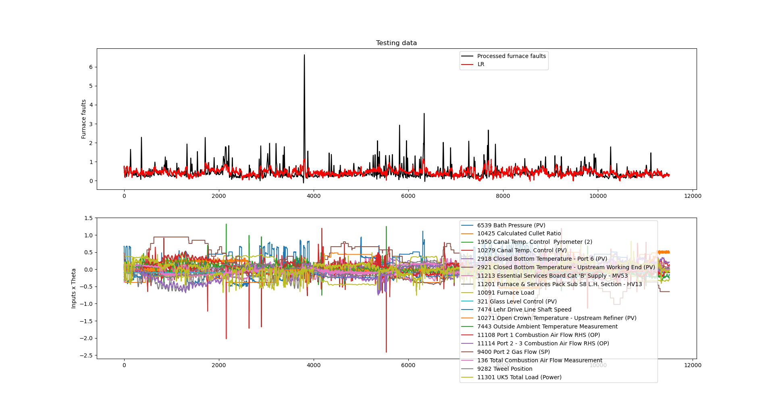
Vary the time lags randomly
MSE = 0.1182

Slide 9
MSE comparison
No significant change in the MSE comparing with the time lags determined by the team.
 | Pilkington | Randomly estimated
MSE | 0.1355 | 0.1182
Even when varying the time lags and the regularisation parameter, the standard LR model seems to capture a very general trend of the faults density.
Low-frequency input features.

Slide 10
Vary the time lags randomly
MSE = 0.1182

Slide 11
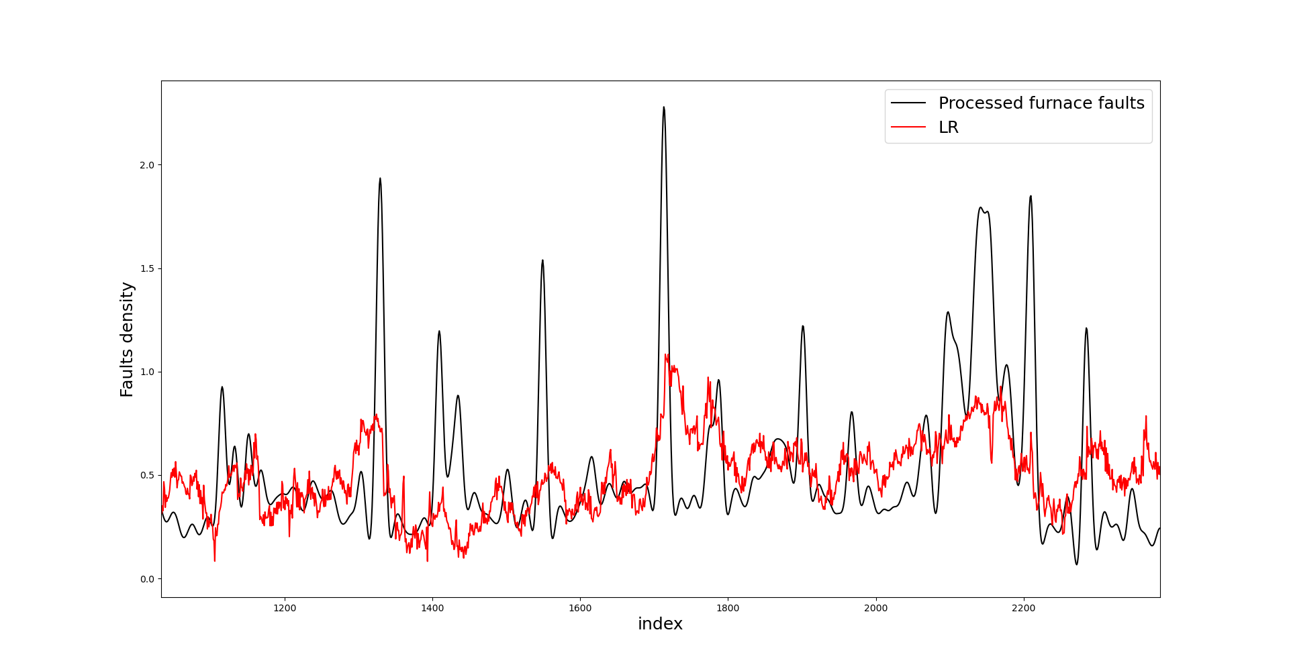
Vary the time lags randomly
MSE = 0.1182

Slide 12
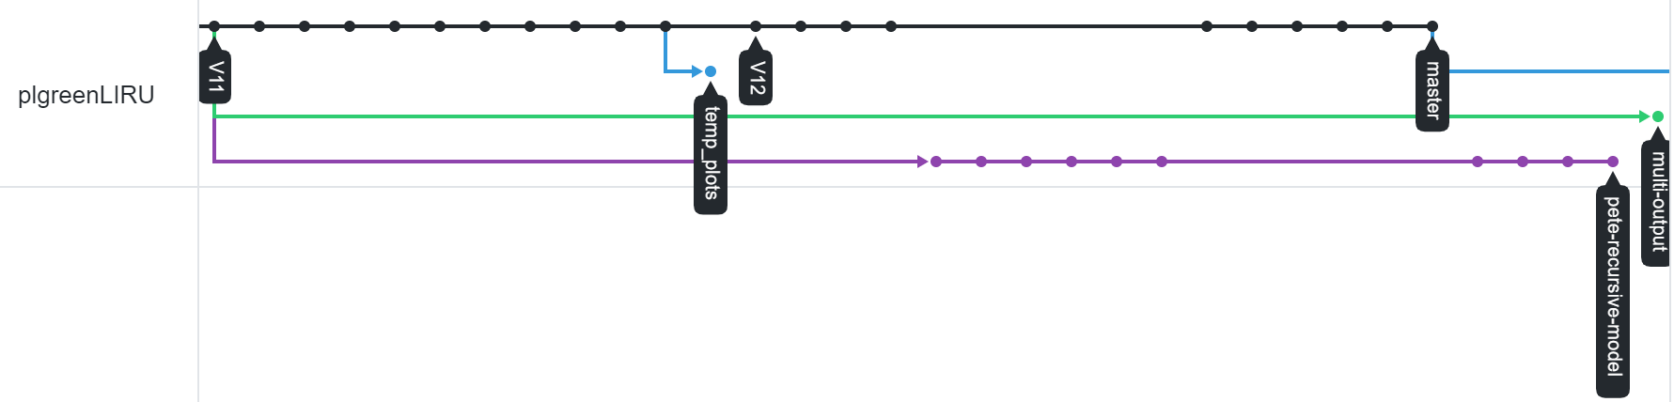
Realising Future Predictions
We have 2 potential ways of realising future predictions
Multi-output regression
Recursive model

Slide 13
Realising Future Predictions
Multi-output regression is running, but not up-to-date with work that has been conducted over the last 2 weeks (we will merge these next week).
The recursive model is close; in this presentation we have some additional mathematical justification for using it.

Slide 14
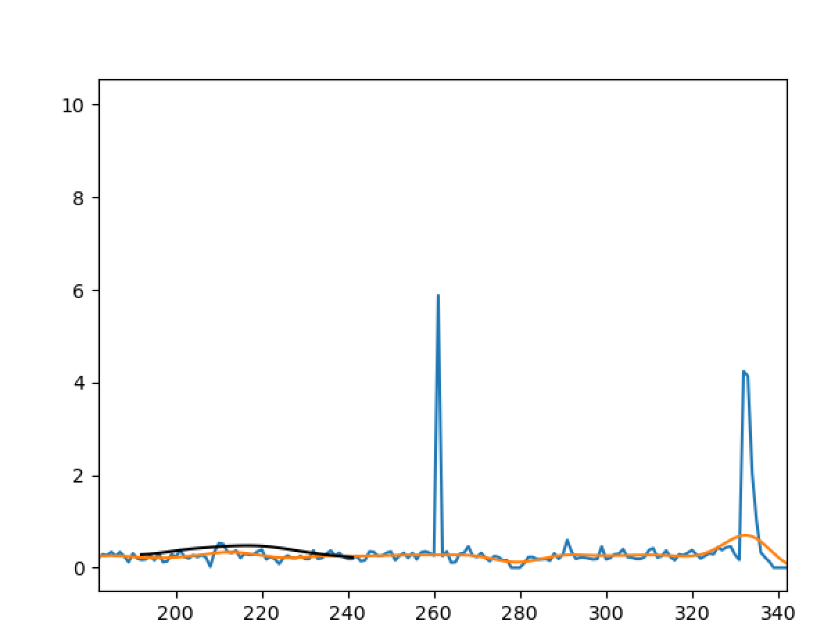
Multi-Output Regression
Pre-processed fault density (note: from ISRA scanner at this point)
Now

Slide 15
Why the Recursive Model?
Here we look at a simplified situation to see what assumptions the recursive model is based upon.
We see that, fundamentally, we are assuming that we can use the earlier states of the furnace to predict later states of the furnace.
This is perhaps closer than we thought to the approach that the Japanese team are using.

Slide 16
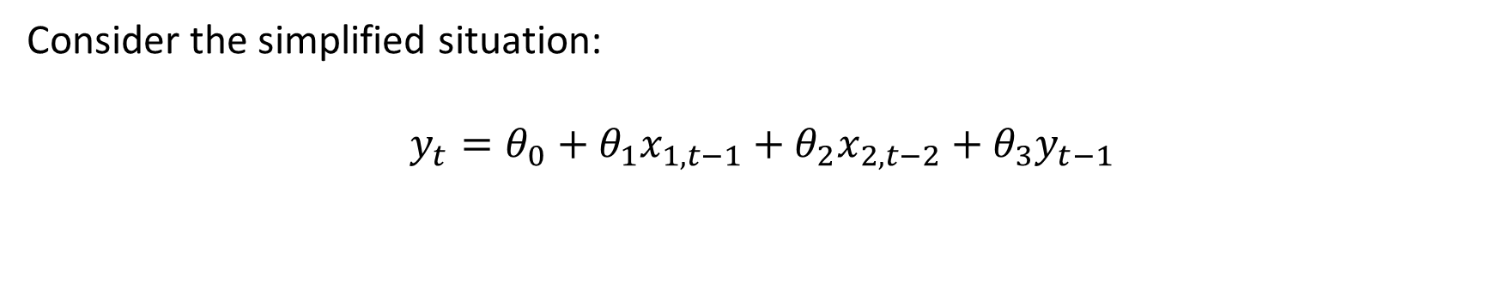
Why the Recursive Model?
Consider the simplified situation:
$$y_{t}={θ_{0}+θ}_{1}x_{1,t−1}+θ_{2}x_{2,t−2}+θ_{3}y_{t−1}$$

Slide 17

Why the Recursive Model?
Consider the simplified situation:
$$y_{t}={θ_{0}+θ}_{1}x_{1,t−1}+θ_{2}x_{2,t−2}+θ_{3}y_{t−1}$$
We can make the first prediction with no problems:
$$y_{t+1}=θ_{0}+θ_{1}x_{1,t}+θ_{2}x_{2,t−1}+θ_{3}y_{t}$$

Slide 18
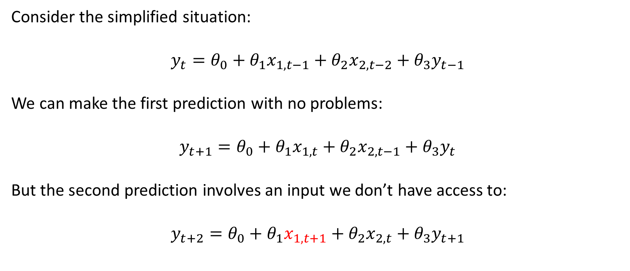
Why the Recursive Model?
Consider the simplified situation:
$$y_{t}={θ_{0}+θ}_{1}x_{1,t−1}+θ_{2}x_{2,t−2}+θ_{3}y_{t−1}$$
We can make the first prediction with no problems:
$$y_{t+1}=θ_{0}+θ_{1}x_{1,t}+θ_{2}x_{2,t−1}+θ_{3}y_{t}$$
But the second prediction involves an input we don’t have access to:
$$y_{t+2}=θ_{0}+θ_{1}x_{1,t+1}+θ_{2}x_{2,t}+θ_{3}y_{t+1}$$

Slide 19
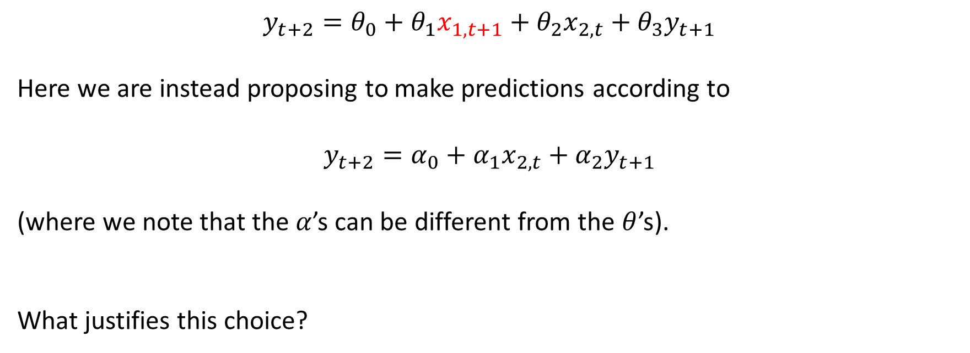
Why the Recursive Model?
$$y_{t+2}=θ_{0}+θ_{1}x_{1,t+1}+θ_{2}x_{2,t}+θ_{3}y_{t+1}$$
Here we are instead proposing to make predictions according to
$$y_{t+2}=α_{0}+α_{1}x_{2,t}+α_{2}y_{t+1}$$
(where we note that the $α$’s can be different from the $θ$’s).
What justifies this choice?

Slide 20
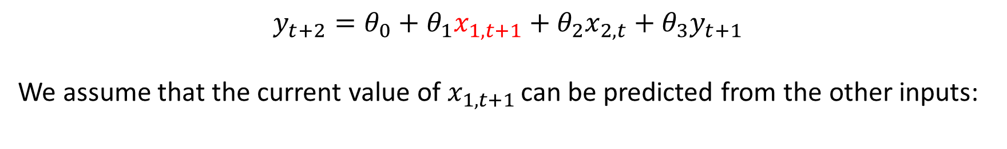
Why the Recursive Model?
$$y_{t+2}=θ_{0}+θ_{1}x_{1,t+1}+θ_{2}x_{2,t}+θ_{3}y_{t+1}$$
We assume that the current value of $x_{1,t+1 }$can be predicted from the other inputs:

Slide 21
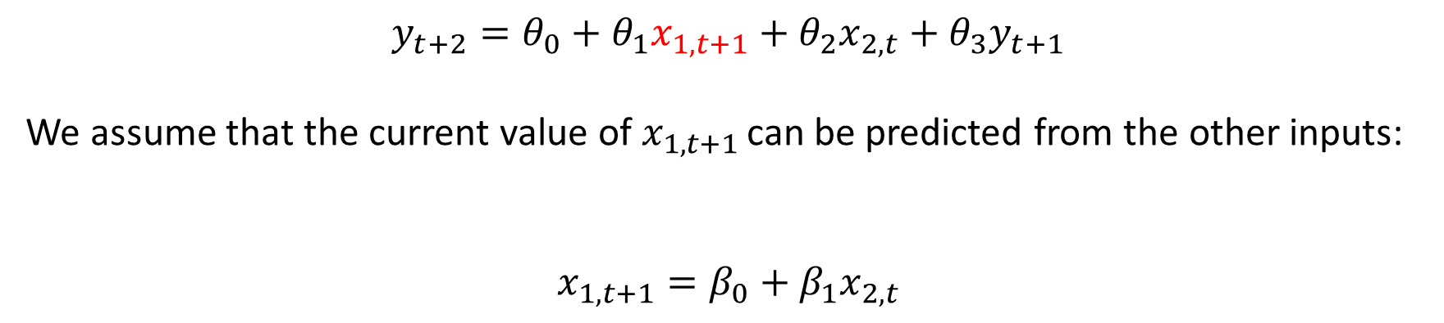
Why the Recursive Model?
$$y_{t+2}=θ_{0}+θ_{1}x_{1,t+1}+θ_{2}x_{2,t}+θ_{3}y_{t+1}$$
We assume that the current value of $x_{1,t+1 }$can be predicted from the other inputs:
$$x_{1,t+1}=β_{0}+β_{1}x_{2,t}$$

Slide 22
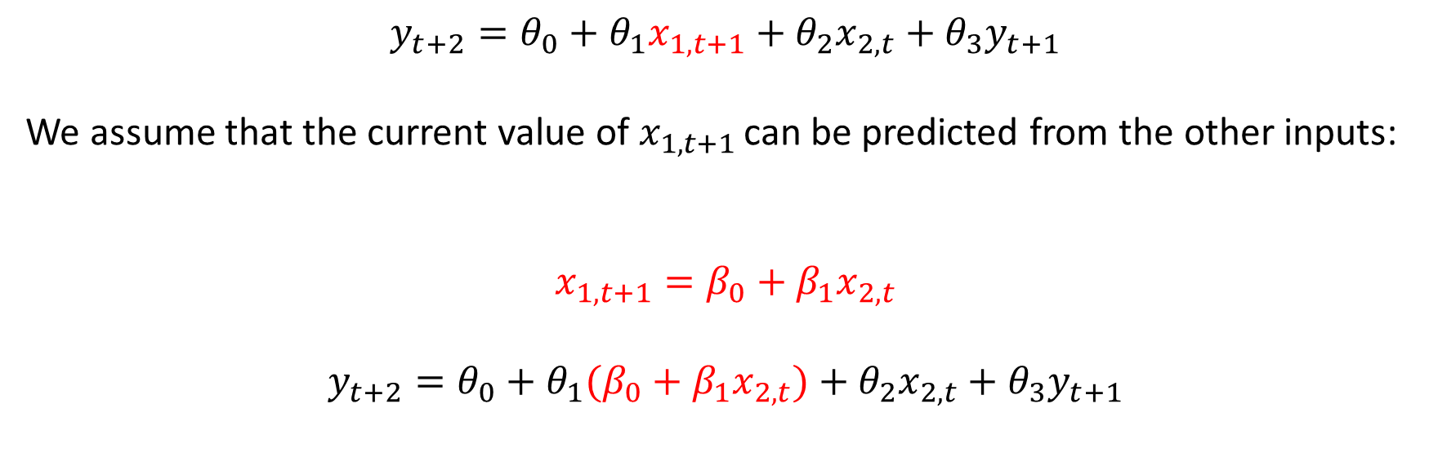
Why the Recursive Model?
$$y_{t+2}=θ_{0}+θ_{1}x_{1,t+1}+θ_{2}x_{2,t}+θ_{3}y_{t+1}$$
We assume that the current value of $x_{1,t+1 }$can be predicted from the other inputs:
$$x_{1,t+1}=β_{0}+β_{1}x_{2,t}$$
$$y_{t+2}=θ_{0}+θ_{1}(β_{0}+β_{1}x_{2,t})+θ_{2}x_{2,t}+θ_{3}y_{t+1}$$

Slide 23
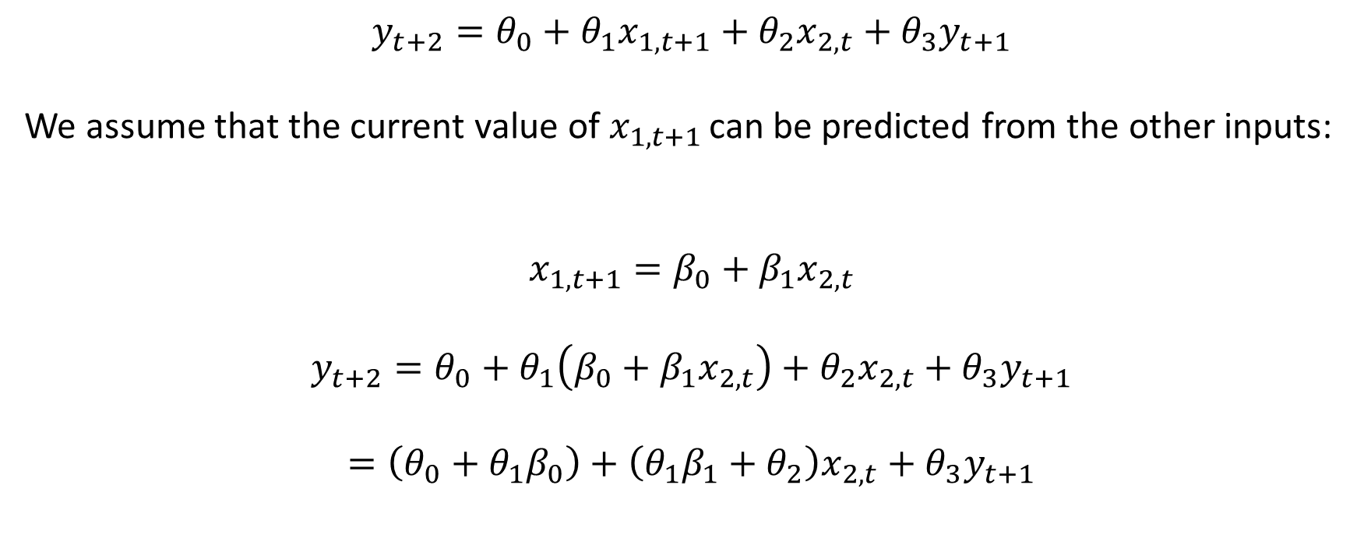
Why the Recursive Model?
$$y_{t+2}=θ_{0}+θ_{1}x_{1,t+1}+θ_{2}x_{2,t}+θ_{3}y_{t+1}$$
We assume that the current value of $x_{1,t+1 }$can be predicted from the other inputs:
$$x_{1,t+1}=β_{0}+β_{1}x_{2,t}$$
$$y_{t+2}=θ_{0}+θ_{1}\left(β_{0}+β_{1}x_{2,t}\right)+θ_{2}x_{2,t}+θ_{3}y_{t+1}$$
$$=\left(θ_{0}+θ_{1}β_{0}\right)+\left(θ_{1}β_{1}+θ_{2}\right)x_{2,t}+θ_{3}y_{t+1}$$

Slide 24
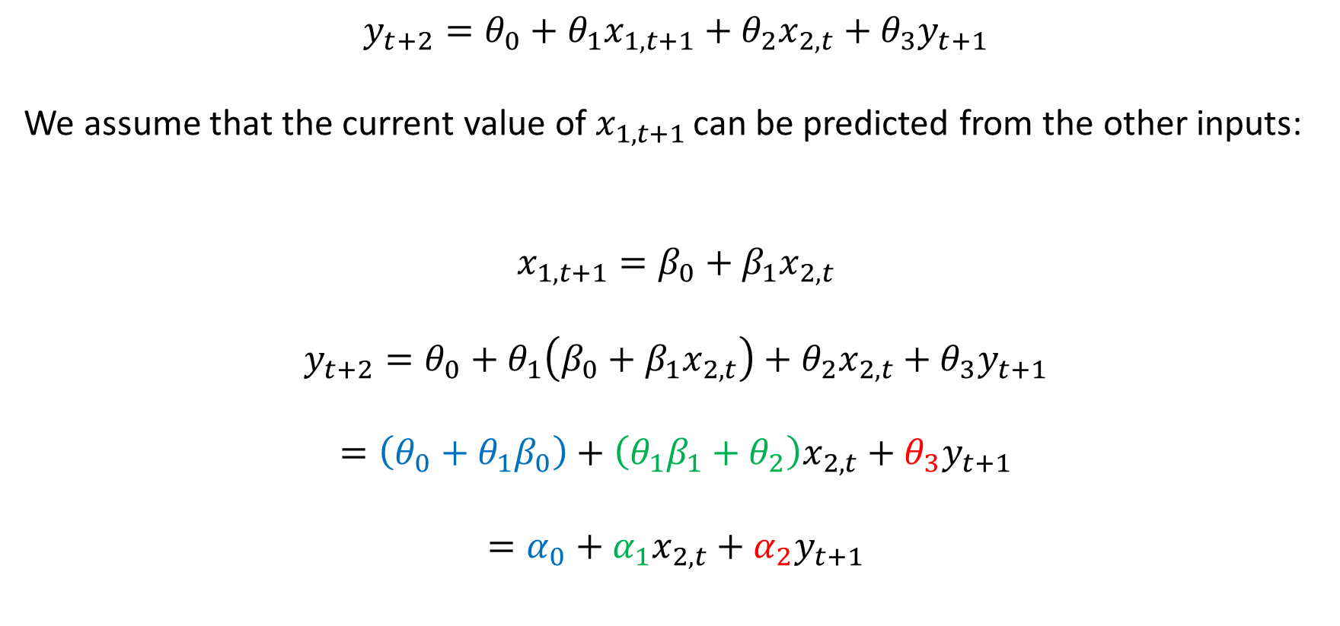
Why the Recursive Model?
$$y_{t+2}=θ_{0}+θ_{1}x_{1,t+1}+θ_{2}x_{2,t}+θ_{3}y_{t+1}$$
We assume that the current value of $x_{1,t+1 }$can be predicted from the other inputs:
$$x_{1,t+1}=β_{0}+β_{1}x_{2,t}$$
$$y_{t+2}=θ_{0}+θ_{1}\left(β_{0}+β_{1}x_{2,t}\right)+θ_{2}x_{2,t}+θ_{3}y_{t+1}$$
$$=\left(θ_{0}+θ_{1}β_{0}\right)+\left(θ_{1}β_{1}+θ_{2}\right)x_{2,t}+θ_{3}y_{t+1}$$
$$=α_{0}+α_{1}x_{2,t}+α_{2}y_{t+1}$$
Recursive model

Slide 25
Why the Recursive Model?
Key assumptions is that we can predict tag data with small time lags from tag data with larger time lags.
If this is true, then why use the tags with smaller time lags at all?
We can trust direct measurements of the tags with small time lags more than the values we predict from tags with large time lags.
Next step is to get the recursive model structure working on the test-example shown here; once this is working we will apply it ‘in anger’.

Slide 26
Final Note
“ Effective AI has the potential to empower human decision-makers, providing them with information and insights they might otherwise have lacked, expanding and improving their available options.”
“Conversely, poorly designed or implemented AI can disempower, removing human agency from a process or masking the role of the software in decision-making.”
https://www.gchq.gov.uk/pdfs/news/artificial-intelligence.pdf

Slide 27
Thank you for your attention. ANY QUESTIONS?

